Slide 1
To Tell the Truth: Imperfect Information and Optimal Pollution Control
Evan Kwerel
As told by Qu Tang

Slide 2
Research Question:
How to induce firms to reveal their true abatement costs in pollution control

Slide 3
Basic Setting:
n firms, one pollutant, the same impact on the environment
Let X_{j} be firm j’s output of pollution, and be firm j’s output of pollution without regulation
Each firm j has abatement cost C_{j}(X_{j}), C’_{j}(X_{j})<0 and C’’_{j}(X_{j})>0
Aggregate abatement cost function is the minimum total cost of achieving pollution level X
_{s.t.}
Assume an interior solution, then at the minimum

Slide 4
Assume an expected damage function D(X), where X is the total amount of pollution discharged, D’(X)>0, D’’(X)>0
Regulator:
The optimal X_{j} ’s must satisfy: (*)
Assume the regulator knows nothing about the aggregate abatement cost
Each firm j reports its abatement cost function
Then,

Slide 5
Strategic Behavior under Two Policies
1) Pure Licensing
The regulator plans to issue L transferable pollution licenses
p: competitive market price of a license
Firm j:
FOC:
By the regulator’s optimization problem, the socially optimal L has to satisfy or
Each firm j reports to minimize p
Since dL/dp<0, each firm will always report a to make L as big as possible, which makes the reported cost information not useful

Slide 6
Strategic Behavior under Two Policies
2) Pure Effluent Charge
The regulator plans to charge e per unit of pollution
Each firm j: , FOC:
The social optimal e has to satisfy
or
To minimize e, firms would like to understate the abatement costs

Slide 7
A Mixed Effluent Charge-License Plan
2 parameters:
L transferable licenses are issued
A subsidy of e per license in excess of emissions is paid to firms holding such licenses
Firm j:
Regulator requires firms to report their abatement costs and sets L and e such that
Under this policy, each firm’s total costs are minimized when the regulator sets the socially optimal effluent subsidy and stock of licenses

Slide 8
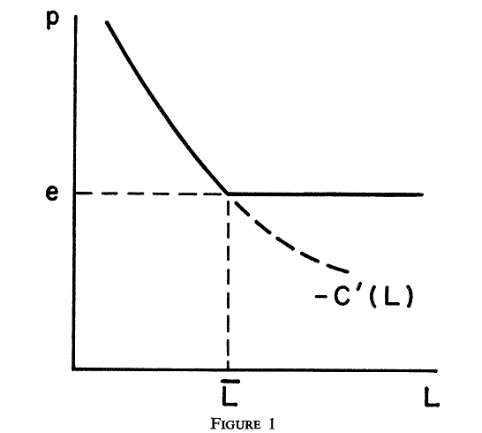
Proof:
Fix e, market demand for licenses
The equilibrium price of L licenses is

Slide 9
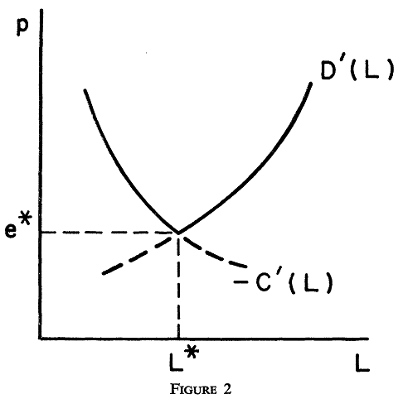
Proof continued…
e is related to L by , so the equilibrium price is
Set and satisfy
The equilibrium price of licenses , where and (social optimal condition)
And also gives the
global minimum of licenses
price, which minimizes
each firm’s cost function

Slide 10
Equilbrium price
Lying: The red line is a false report.
As a result the center will set L too low
At L**
Therefore (look at equation above and
Notice it is in terms of the real C’ not
The false report.
P goes up as it is –C’(L**) > -C’(L*)
Blue line shows the other side. Now p goes
Up because D’(L***) > D’(L*).
Higher prices are always worse for firm
So lying implies higher prices implies worse.
Firms report the truth.
L**

