Slide 1
Environment:
Theories and Programs
© Peter Berck 2006,2010,2011

Slide 2
Basic Concepts
From Emission to Harm
Marginal Cost of Abatement
Standards
Taxes

Slide 3
Emissions to Harm where to intervene multi-media
Emissions
Trees &
Lakes
Media (air)
Chemistry
Emissions
people
Alt Media
water
Ambient air quality
Notes:
Many sources emit to many media. Within the medium there are chemical reactions (like smog). Result is ambient quality. People and things take results of ambient quality and that is harm.
Even if you know the harm to people from ambient quality, you do not necessarily know the harm from emissions.
If you control the emissions to one media, it might go to another (MTBE goes to water)

Slide 4
Inputs to Emissions: pollution prevention v. cleanup
Input
Process
Cleanup
Emission
Input
Pollution prevention vs. Cleanup
Notes:
Pollution prevention includes things like solvent recycling or replacement of exotic solvents with soap and water; or low sulfur coals or nat gas (fuel switching); or more efficient processes so there is less waste. PP can often pay for itself. (Story of molded parts factory)

Slide 5
Fundamental Eq of Pollution
Pollution =
Sum over activities of
Output times pollution/output
Abatement requires some of
Less output from polluting sectors
Make gdp smaller or change composition
Better pollution/output
Cleanup or pollution prevention

Slide 6
In econ terms
Need to get sectoral output right—if it pollutes it probably has too much output relative to social optimum
Need to get right point of isoquant

Slide 7
High Level View
q output
a effluent
C(q,a) minimum cost to make q while emitting a. C is non-increasing in a.
-dC/da is the marginal cost of abatement
π(P,a) = max_{q}(Pq –C(q,a))
By envelope theorem dπ/da = -dC/da.
An increase in emissions raises profits by marginal cost of abatement.

Slide 8
Market Model
Damage from emissions is D(a)
Free market: choose a to maximize π
-C_{a} =0.
Social Planner choose a to max π – D(a)
-C_{a}(q*,a*) = D’(a*)

Slide 9
Tax and Standard
t = D’(a*) is the optimal emissions tax
Firm max_{a} π(P,a) - ta
a* is the optimal emissions standard
Firm max_{a} π(P,a) s.t. a < a*
In both cases a* is the chosen emissions
difference is that with a tax t a* is the tax revenue that goes to the government.
Firm (of course) prefers standard
P constant drives the equivalence
Notes:
Here the level of profit has no influence on the long run supply. Hence no polluter pays principle.

Slide 10
Helfand’s Lettuce
Diagrams and much ancillary material from Berck and Helfand.

Slide 11
Leaching and Agriculture
Leaching of nitrates to ground water.
Apply water and nitrogen to land
Part of water that is applied becomes evapotranspiration and helps plant to grow
Part becomes leaching fraction and pulls remaining salts to ground water
Art of irrigation is getting leaching fraction right.

Slide 12
N Pollution
As water applied goes up it takes more leachate to groundwater.
Lettuce is grown using water and nitrogen
Notes:
Example is due to Helfand and House.

Slide 13
Marginal Cost of Abatement Made Real
Isoquant: all bundles produce same
Isopleth: all bundles pollute the same
Isocost: all bundles have same cost
Example. Lettuce
Nitrogren + Water = polluted leachate goes to ground water
Also are inputs to lettuce, measured as dry matter in tonnes per hectare

Slide 14
Compare input tax to effluent standard

Slide 15
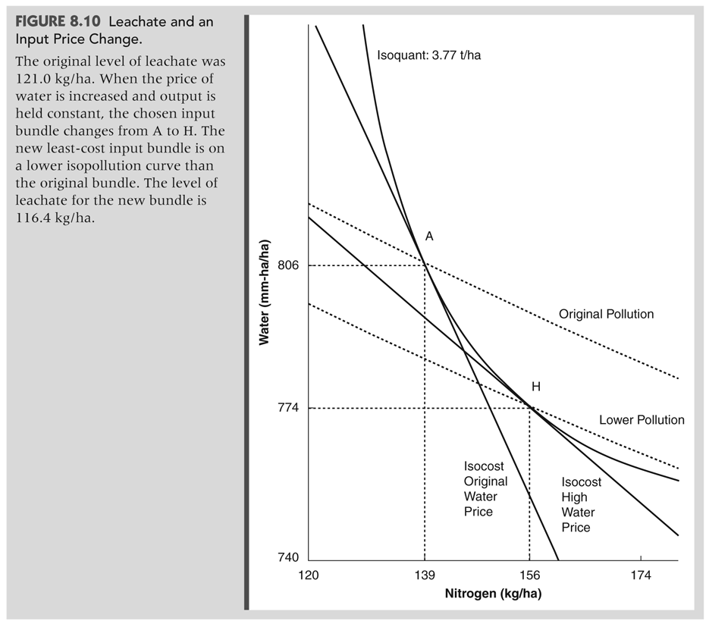
Water price up, N price constant
Notes:
Since N price is constant, cost is proportional to intersection on horizontal axis.

Slide 16
Effluent standard cheaper than a tax
Picture shows how a price increase for water moves to a higher N/Water ratio.
Need to draw one more line to show that price change costs more.
Through H and parallel to isocost original cost

Slide 17
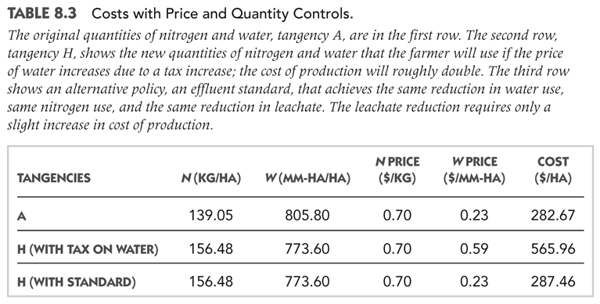
Saves 5kg/ha of leachate

Slide 18
MCA
{C(Q;121kg) – C(Q; 116kg) } / (121-116)
MCA is about $1/kg per ha.

Slide 19
Control Alternatives

Slide 20
Types of Standard
Emission standard
Lines up with model
Requires measurement of emissions
Hard to do with leachate, autos, and so on
Point source = can measure
Non point source = too expensive to measure
Hard limit (e.g. 4 tons NOx)
RECLAIM and other cap’n’trade systems have hard emissions limits

Slide 21
Other types of standards
Input standard
Must use natural gas not coal.
Must use low sulfur coal
Must not use more than 1 ton sulfur
Look back at lettuce example: for least cost
Water limit will work
N limit will not work

Slide 22
Emission per unit
Output
Water permit system gives discharge permits as function of plant capacity.
Since plants don’t run at capacity much, system doesn’t constrain plants much.
Input
95% of the sulfur in the coal must be removed.
Notorious predecessor to CAA acid rain provisions

Slide 23
Technology Standards
Building codes
Must use insulated windows
E.g. Must use catalytic converter on car
Compare to x gms per mile, an emission/output standard, which is met with a catalytic converter (CAA act does this)

Slide 24
Technology Based Effluent Standards
TBES
Used in CAA and CWA
An emissions standard
Level is set as that which can be achieved with a reference technology
E.g. A 6 speed transmission can reduce co2 emissions by 12%, therefore cars must abate 12% (by any method they choose.)

Slide 25
Technology Based Effluent Standard
Regulator finds a technique that uses less air
and sets standard C as the amount of air used by
that technique
Other input
Draw isocost to show cost of TBES
A technique that uses C units
of clean air services
Cost minimizing technique
C
Clean air services

Slide 26
Summary
Standards:
Many forms possible
TBES are used in CAA and CWA
Scaled by output capacity was usual
Absolute value in trading schemes
Does that explain why trading schemes are harder edged than previous regulations?
Building permits are technology standards

Slide 27
Major Laws in the US

Slide 28
NEPA
National Environmental Policy Act
Purely procedural
Must prepare EIS
http://www.epa.gov/compliance/basics/nepa.html
Increased transaction costs for all development projects

Slide 29
Endangered Species Act
May not take an endangered species.
Take permits needed to develop land
Habitat Conservation Plans
Typical: deed some portion of property to conservation use in exchange for take permit.
Conservative View: This is simply an uncompensated taking.

Slide 30
LEDPA Process
Section 404 of Clean Water Act requires preservation of wetlands.
It is very rough. First have to show that the project can’t be done somewhere else. Hard showing.
Then have to mitigate. For instance buy the salt ponds in SF bay and return them to wetlands in exchange for a runway.

Slide 31
Limitations
To waterways of the US. (navigable and also a claim under commerce clause)
A non connected quarry isn’t a wetland.
A vernal pool that eventually makes it into a river is.
Navigable means could drag a canoe up it.
So most waterways in US fall within act.

Slide 32
Clean Air Act
Landmark legislation
Sets out comprehensive scheme to control air pollution
Has 5 logical parts

Slide 33
1. National Ambient Air Quality Standards.
A. The EPA sets goals for how clean the air must be based upon public health. See http://www.epa.gov/air/criteria.html for the current standards. The criteria pollutants regulated by NAAQS include NOX, SOX, etc.
B. The States are required to make regulations on stationary sources that will bring the state's air into compliance with NAAQS. The State does this by writing a State Implementation Plan.
Notes:
California has an unusual sip as it regulates more than point sources

Slide 34
NAAQS
Nonattainment areas have to have plans to come into attainment
Plans limit emissions from stationary sources, like power plants
Typically, bigger plants got more emission rights
But, the rights don’t increase if the plant gets bigger

Slide 35
States
States through SIP process must control emissions to produce an improvement in air quality
And eventual compliance with NAAQS

Slide 36
Much new empiricism: start with
Greenstone: http://www.nber.org/papers/w8484
CAA rearranged investment in us away from non-compliant counties
http://www.sciencedirect.com/science/article/pii/S0095069604001202
Becker; PACE survey shows that polluters do spend more on pollution control.

Slide 37
Extreme Response to SIP: RECLAIM
South Coast Air Quality Management District has responsibility for stationary sources in LA basin (delegated from CARB)
Runs a cap and trade program in NOX, SOX and ROG.
Supplants TBES in State Imp. Plan
RGGI is second program (NE power plants also trade)

Slide 38
Marketing Air Pollution
Long history of Bubbles and Other trading Schemes
South Coast allows market in pollution RECLAIM
amount of permits decrease each years
“solves” problem of mc different for different firms
National Market in SO2. Price lower than expected

Slide 39
2. NSPS
New Source Perfomance Standards
(For the statute:
http://www.access.gpo.gov/nara/cfr/waisidx_99/40cfr60_99.html). New sources of air pollution are limited in their emissions. These emission standards are tighter in areas that have worse air. Hence, it is thought to be better for your regions economy not to be a non-attainment area. TBES is the form of NSPS.

Slide 40
NSPS
But even in pristine areas a new source must limit its emissions
Limits trading of pollution and jobs from dirty to clean places
Phrased as non deterioration.

Slide 41
NSPS Politics
Power plants in operation in ’72 were grandfathered
They can continue to emit more than permitted by NSPS
So long as they do not have any physical modification
Idea was that as the plants deteriorated and were replaced new plants would be cleaner
But no major disruption from standards.

Slide 42
Grandfathering
Old sources do not have to adopt as strict pollution control technology as new sources.
Therefore they have lower costs.

Slide 43
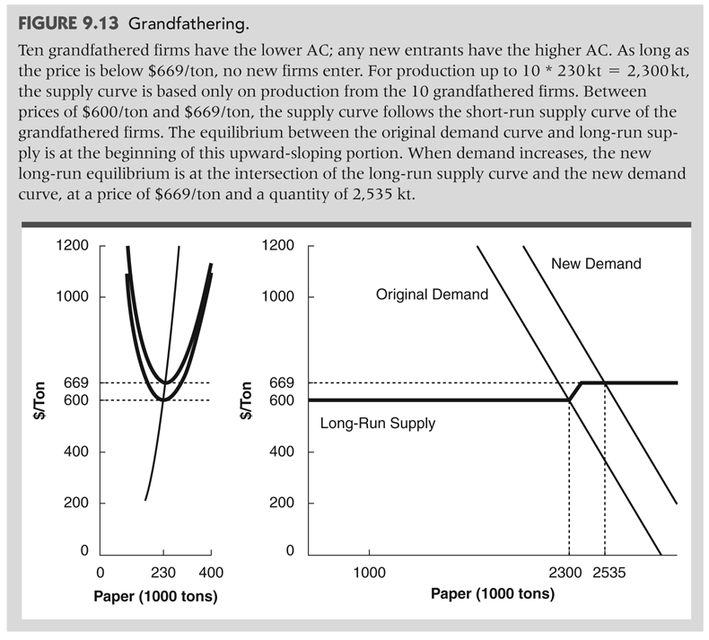
Grandfathering.

Slide 44
Coal
Is naturally dirty
Gives rise to sox, nox, and particulates
Pm10, pm2.5. Can also be toxic
Mercury is common
Is expensive to clean up
Low sulfur coal is cheap
Scrubbers are expensive
Nox removal, mercury removal, expensive

Slide 45
Clinton
Found that coal fired power plants had knowingly made major modifications and not come into compliance with NSPR.
Sued. finally settled
Bush admin promised more industry friendly rules
Court eventually struck down rule that ?20% of capital costs per year were mere maintenance.
Duke Energy—Supreme court sided against companies. AEP settled.
Notes:
Read the NYT magazine article or the decision to get the full flavor of the Bush admins actions.
Duke Energy shows how arcane the argument was.

Slide 46
3. National Emission Standards for Hazardous Air Pollutants.
For instance for radiation: http://www.epa.gov/radiation/neshaps
Much stricter than criteria pollutants like sox and nox.
Calif threatened to prove diesel exhaust was a hazardous air pollutant as a way to make EPA allow regulation of trucks and such
Notes:
CA can’t meet the NAAQS without large changes in trucking, trains, ships, and ports all of which were thought to be the exclusive domain of EPA.

Slide 47
4. Mobile Sources.
The EPA directly regulates mobile sources and sets the limits of what they may emit for NOX and so on.
Of the States, only California may adopt more stringent regulations and if it does so other states may follow California.
Notes:
CA regulated cars before the CAA, hence the grandfathered first mover right. Also much worse air.

Slide 48
GHG: waiver of federal preemption
CA has exploited its special status in the CAA to regulate GHG
Required a ?25% cutback in fleet average GHG output.
Typical CAA: First found health hazard. Then found technologies (6 speed transmissions). Then set emission standard.

Slide 49
Clean Air: Non-point Sources
cars: grams of NOX per mile;
Calif: mandatory zero pollution vehicles as part of fleet
Heavy Trucks and Trains
FIP versus the SIP: Calif goals
40%?! of remaining cleanup-able pollution in South Coast
Boats: Water vs. Air Pollution and MTBE

Slide 50
Mobile: Role of Econ
Choosing technologies within a certain cost range.
Only in CA:
explicit calculation of cost per ton cleaned up
Impact on state gdp, jobs etc.
No fed regulation for this type analysis

Slide 51
5. Acid Rain
National trading program in SOX from power plants.
Cap and trade.
Auction of some rights
http://www.epa.gov/airmarkets/arp/
(also extensive econ literature)
Notes:
Taken as a poster child for cap and trade. Originally it was thought that the rules would lead to the purchase of scrubbers. Turned out that the powder river coal basin with low sulfur coal came on line at just the right time and the cost of permits was only about $100 per ton, way less than anticipated.

Slide 52
Cost of acid rain
The program is for trading of allowances, but
Firms also subject to new source standards
And SIP regulations
So it is trading after already cleaned up somewhat.
Powder river basin coal.

Slide 53
Responsible to Whom?
Plant in LA could be
In Reclaim
Subject to NSPS
Hazardous air pollutants
Acid rain trading
So would be responsible to state and feds and in 4 different programs!
Just for Air!!

Slide 54
Demand Side Measures
Public utilities used to charge AC < MC for their services.
Welfare would increase when energy saving appliances/insulation was purchased with an effective subsidy per unit of power of MC-AC.
Subsidy of mass transit.
Welfare would also increase if price were increased to MC.
Less energy implies less pollution.

Slide 55
Water
1972 Water Pollution Control Act Amendments
The Clean Water Act
Goal of NO Discharge
impossible
Unmet

Slide 56
Two Remaining Strings in the Bow
1. NPDES. A nationally run TBES system for effluent discharge to water.
2. TDML. A state run program to further reduce discharge.

Slide 57
0. Sewage
US used to subsidize sewage treatment. I think this was spectacularly effective.
Reasons to turn it off: Liberals-it encouraged sprawl. Conservatives-it cost money
Can swim in little neck bay; beaver in bronx river; shipworms in the hudson.

Slide 58
1. NPDES
Every point source discharge must be permitted by USEPA

Slide 59
NPDES-TBES
Industrial sources have TBES
some say that the TBES are tantamount to a technology standard because doing what EPA says seems to grant immunity
Existing sources now held to Best Available Control Tech. (more stingent than best practicable which has cost/benefit test, which BAT does not.
backlash
now confused system depends upon toxicity
new sources more stringent regs.

Slide 60
Form of the Standard
Plant capacity is determined
Emission permits are given as fraction of capacity.
Water discharge permits almost always exceed actual discharge. (Why?)
Could have permits by output or input.
(See G.E. Helfand Standards vs. Standards)

Slide 61
TDML
CWA requires states to set water ambient water quality standards for each body of water. (e.g. swimmable, drinkable, fishable, etc)
Once a standard is set, state must find Total Daily Maximum Loads (total emissions) that lead to that quality
Then they must limit point sources so that TDML’s are not exceeded.

Slide 62
No Federal Forcing
Unlike CAA, CWA has no equivalent to the Federal Implementation Plan, so USEPA cannot force states to set standards (e.g. swimmable)
or to back up standards with TDML’s (total emissions) and back those up with emissions permits by firm (except by lawsuit)

Slide 63
Why Clean other States Water?
Missouri River in Montana has too much N and other pollutants to be purifiable with a portable filter.
Most of the US is downstream..
I benefit, you cost! Why clean up.
Montana had set TDML’s for only small streams on national forests last time I looked.

Slide 64
Non Point Water Pollution
epa leaves to the states!
Porter Cologne does NOT exempt ag. (CA)
Agriculture is exempt from CWA
(cf. Baltic region agreement on K and N runoff)
But CAFO’s are treated like industry.

Slide 65
FIFRA: Pesticides--registered and permitted
now being de-registered
residue controlled
leaking to groundwater regulated by state
In CA by initiative
http://www.epa.gov/pesticides/regulating/ for FIFRA
CA regulation requires reporting, hence we know by crop by time.
Notes:
Sunding, zilberman, and siebert are the people to talk to on costs

Slide 66
Resource Conservation and Recovery Act
Toxic waste
Manifest--tracking of waste
Proper disposal
Very different from Mexico where there are not sufficient dumps and there is no tracking. Barrels fall off trucks.

Slide 67
TRI
http://are.berkeley.edu/~sberto/TRI-Draft.pdf
Jason Scorse shows the effect of being in the top ten polluters.

Slide 68
Superfund
CERCLA--Superfund
Fund to pay for cleanup of old wastes
Original money was tax on chem industry
To be replenished by payments from polluters
Love Canal
Burried waste in old canal
School District took land for school
Barrels resurfaced and killed yards
Hence an act to take care of things like this

Slide 69
Superfund II
One who finds waste being discharged to environment must report.
EPA identifies potentially responsible parties
Strict liability: any responsible can be made to pay whole cost
Since burried wastes leak after you bury them,
All owners of site are responsible, not just the burrier!
You Touched It, You're Responsible
After much litigation, responsibles must pay for cleanup.
PCB’s on bottom of hudson
PCB’s on bottom of Umealven (sweden) same deal.
100’s of millions of $

Slide 70
Damages
Ability to sue for Natural Resource Damages
Exxon Valdez
Clean up
Damage to fishery
Existence value for locals.
This act spawned the fight over CV between Exxon(Diamond, McFadden et al) and Alaska (Carson, Hanemann et al.)

Slide 71
Swedish Policy
Big reliance on taxes
But not for industry as much as households
Carbon, Nox, mining all pay
Gas is 6-8 USD/gallon all over Europe
Strict liability everywhere
NEPA like process that results in trials on the merits (not process)
Government is sovereign and can step in and build a project anyway.

Slide 72
Sweden, con’t
Nuclear, hydro, and waste make heat and electricity using district heating plants
No combustion in homes at all.
Slow but noticeable cleanup of paper mills to closed bleach cycle odorless plants
Emphasis on rail, compact cities, public transport, yet subsidies! For commuting from outlying small villages

Slide 73
Bottom Line
Carbon targets with EU exceeded.
One can both breathe and swim, nearly everywhere.
And this done with steel, autos, etc—they are Detroit not Calif.

Slide 74
China
Population policy will save at least .4 billion people from consuming. Nobody else makes this kind of sacrifice.
Rebuild cities so that walk to subway < 300m. Everywhere in Beijing. E.g. a 16 million person version of Paris.
Turn off junk plants from great leap forwards
Many other policies—but not big gas tax yet.

Slide 75
Classical Environment

Slide 76
Classical Environment
We derive the polluter pays principle and from there and the usual assumption of CRTS in the long run get the
Consumer pays principle

Slide 77
Taxes or Standards
Income distribution
Firms prefer standards
Efficiency
A TBES doesn’t get MC right
Coase
Efficiency through property rights

Slide 78
Output = Pollute
the easy case to graph
no issue with gunk per unit output. it is ONE.

Slide 79
Set Up
D
MC
MC_{f} + MC_{p} = MC.
Arrows are same size and show
that distance between MC and
MC_{f} is just MC_{p}
MC_{f}
p
MC_{p}
Before regulation supply is MC_{f} and
demand is D, so output is q_{p}.
q_{p}

Slide 80
Competitive Solution
D
Before regulation supply is MC_{f} and
demand is D, so output is q_{p}.
MC
Profit = p q_{p} - area under MC_{f}
Surplus is area under demand
and above price.
And pollution costs are are
under MC_{p}
MC_{f}
p
MC_{p}
q_{p}
We assume FC = 0 for convenience

Slide 81
Maximize W - All costs
D
Supply, MC, equals demand
at q_{s}
MC
Profit - pollution costs
= p q_{p} - area under MC
= W - all costs
To expand output to q_{p}
one incurs a social loss of
the red area: area under
MC and above demand
p
MC_{f}
MC_{p}
q_{s}
q_{p}
We assume FC = 0 for convenience

Slide 82
Deadweight Loss of Pollution
D
MC
{Maximum W - all costs}
less
{W - all costs from
producing “competitive” output}
=
Deadweight Loss
p
MC_{f}
MC_{p}
q_{s}
q_{p}
We assume FC = 0 for convenience

Slide 83
A tax can achieve q_{s}
T
D
$/unit
MC
Tax T=MC-MC_{f} at q_{s}:
Makes demand to firm D⁻¹(q) - T
which is red line, D shifted down
by T. Firm now produces at
MC_{f}(q_{s}) = D⁻¹(q_{s}) - T
MC_{f}
MC_{p}
units
q_{s}

Slide 84
Firms Prefer Controls to Taxes
Before regulation profits are
red and pink areas
MC
Tax T=MC-MC_{f} at
q_{s}: Q is still q_{s}, green
area is tax take and only pink
remains as profit
MC_{f}
MC_{p}
When regulation reduces Q
Profits are the pink plus
green areas.
Unreg. Q
q_{s}
Notes:
I believe this is Baumol and Oates

Slide 85
An Output Tax or Standard
DOESN’T REALLY DO IT

Slide 86
The full problem
Let U(q) be total willingness to pay
Area under the demand curve, p(q).
U’ is then p, the price.
a is effluent
q is the output of the good

Slide 87
Social problem
Max on q and a
U(q) – D(a) – C(q,a).
Assuming interior solutions, the resulting first-order conditions are
U_{q} = C_{q}
p = mc
−C_{a} = D_{a} .
mc of abatement = marginal damage
Notes:
Expand to pre existing tax on output.

Slide 88
It is usual to concentrate the answer in a by first finding the optimal q(a) and then
max_{a} U(q(a)) – D(a) – C(q(a),a)
(p q’ – C_{q} q’) –D’ – C_{a} = 0
first terms are zero by p = mc
back to marg damage = marg cost abate

Slide 89
Think about MCA
What happens to marginal cost of abatement as we subtract effluent?
-C_{a}(q(a), a)
The direct effect through a means we ride up the mca curve.
The indirect effect is that we make less output (logically, at least) and it is harder to abate on margin when there is less output. Curve shifts in.

Slide 90
MCA(q(a),a)
MCA(q(a),a)
MCA(q,a)
abatement

Slide 91
Two margins to reduce pollution
Lower quantity
Lower emissions/quantity

Slide 92
AREA under MCA…

Slide 93
Does MC shift in?
mc increases in w (price of clean air) when
Factor demand, X, for clean air increases in Q
derivative of cost is factor demand

Slide 94
Pigouvian Tax
effluent charge of
t = D_{a}(a*)
Now firm will choose
-C_{a} = t
which again gives a* and is fully optimal
Of course now the firm pays t a* in tax

Slide 95
Standard
An emissions standard gives the same answer
Lagrangian for a standard A is
Max _{q, a} Min_{λ} U(q) –C(q, a)+ λ[A – a].
Of course if A = a* one gets the same answer as before and λ has the same value as the tax would have had.

Slide 96
Homework
Now assume that U(q,alf), where alf is a shift parameter that increases demand.
For both a standard and a tax regime, what are the comparative statics wrt alf?
Compare the two cases
This is a comparative statics exercise and it requires derivatives as an answer.

Slide 97
Standard per Firm
. The difference in average production costs under a tax and a standard is
C(q, t*)/q − C(q, a(q, t*))/q = a(q, t*) t*/q .
Since lower costs imply entry, an industry regulated with a standard will have more firms and thus more effluent than one regulated with a tax. (when the firms emit the same effluent)

Slide 98
Long Run CRTS
Show that the right answer in the long run is to pass 100% of the costs onto the consumer.
U(Nq) –NC(q,a)-D(Na)
N P – N C’ or p = mc
P q – C- a D’ = 0 or p = AC+D’ a/q
-N C_{a}-N D’ = 0 or MCA = MD.
So t = D’(N*a*) decentralizes it.

Slide 99
Also consumer pays..
P = AC(q*,a*) +a*/q t
With a standard per firm of a*, the last term would be missing and price would be too low.

Slide 100
Other Instruments

Slide 101
Ambient standard tax
If each firm i (i = 1, . . ., N ) is taxed t on some share s_{i} of total damages, with other firms’ damages assumed to be constant, then each firm will maximize its profits, given by:
Notes:
Kathy Segerson writes about this type of instrument

Slide 102
FOC
The first-order conditions are:
(i) price equals marginal cost of production, and (ii)
–C_{ai} = ts_{i}∂D/∂a_{i} (i = 1, . . ., N firms).
The social optimum will be achieved as long as ts_{i} = 1—that is, as long as each firm is taxed as though it were fully responsible for damages, with the actions of other firms taken as fixed.
requires each firm to make a potentially very large payment, and it is therefore unlikely to be politically acceptable.

Slide 103
Input tax
w input price, t tax, x input, q(x) output
( i = 1, . . ., N polluters; j = 1, . . ., J inputs).
Max_{xi}, pq_{i}(x_{i}) – (w+ t_{i})′x_{i} .
The first-order conditions are
p(∂q_{i}/∂ x_{ji}) = w_{j} + t_{ij}
The social optimum will be achieved only if t_{ij} =(∂D/∂a_{i})(∂a_{i}/∂x_{ji}).
Need every firm to have different t’s
Notes:
Gas tax is a good example. Cars have different emissions per gallon.

Slide 104
Voluntary
Voluntary could be just bargaining in shadow of the law.
Could be used to get reputation which leads to higher sales.
TRI affects pollution, so one assumes a top 10 listing affects profits.
Could allow more input into regulation and hence lower firm cost.

Slide 105
Does it matter if the Polluter Pays
Depends upon how a new entrant is treated.
In a cap and trade program, the total amount of permits is A times number of existing firms
A new firm gets no new permits.
Hence it must buy permits to enter.
Hence its profits are same as firm that must pay a tax.
Here permits and tax are same on the margin.

Slide 106
Demand Increase
In the quota version, an increase in demand automatically increases the shadow value of the quota
But the tax per unit would stay the same and equivalence would disappear.
Need an increasing tax with increasing demand to hold the effluent stable.

Slide 107
Per plant permits
Suppose instead that each new entrant will be given permits.
Like a TBES world. A new polluting water plant would get discharge permits based on TBES calculations.
Now new firm does not buy permits.
Until A = a, λ = 0 for such a firm
Hence not equivalent to a tax.

Slide 108
Per unit output
Incentive to produce: you get price plus you get the value of the additional permits.
Too high a q;
Presumable to meet a target A, is not least cost.
(Can you prove this?)

Slide 109
Math for per unit output

Slide 110
Trading of Permits to Pollute

Slide 111
Coase
If there are small transactions costs, there will be trading, hence a Pareto Optima.
If the PO is unique, then all endowments lead to the same PO allocation.
And the converse. If transaction costs are large, then the endowment is the allocation and it is unlikely the PO. Better choose endowment (liability rule) carefully.

Slide 112
Coase Theorem: succint
When transaction costs are low, the amount of pollution is independent of the allocation of pollution rights.
When transactions costs are high, the amount of pollution depends upon the allocation of pollution rights.

Slide 113
The Law
Nuisance gives a cause of action.
But
Difficult with many plaintiffs
Class action
Difficult with many defendants
Causation unclear
Which company made the smoke
Which farmer had the dbcp?
Share remedies only recently available and not in all states

Slide 114
Classic case for prop rights
Rivers in UK had well defined fishing rights (beats)
Could get courts to enforce no pollution on potential polluters
But notice that the ability to trade rights in this case is very limited—pollution is a public bad, not a private bad. Selling to the polluter can’t be done by just one person.

Slide 115
Coase Stories
Two firms: A = a +a* total emissions
If trading is cheap, outcome is
Max_{a} π(a) + π∗(Α−a)
Else corner solutions dependent on rights
a’ = argmax_{a} π(a)
Value = π(a’) + π∗(A-a’)
Or a’’ = argmax_{a} π∗(A-a)
Value = π(a’’) + π∗(A-a’’)
Notes:
Draw pictures.

Slide 116
Sacred Cars (Meredith et al.) prelim version and drawn by me

Slide 117
Costs without trade
Deadweight loss when all pollution
rights are allocated to agent 2 or agent 1
And trading is impossible.
MCA for
Mr. 1
Bid 2
abatement
Notes:
Mr. 2 can be another firm. Whatever Mr. 1 doesn’t abate he must abate. His curve is MCA read from the right as in previous slide
Mr. 2 can be a victim. His curve is his then read from the left and his declining MBA.

Slide 119
Sacred Cars (Meredith)
“estimates of the marginal abatement costs for point sources far exceed those of mobile sources…. We estimate that these inefficiencies amount to $1.9 billion; this represents over 7 percent of the total costs incurred to comply with both programs.”

Slide 120
Coasian view
Transaction costs of trading between a zillion car owners and manufacturers on one side and power plants on the other side are too large.
Hence, the inefficient regulation is what we have to live with.

Slide 121
However
When two firms trade the spatial distribution of the pollution will be different.
Trading can be a mechanism to inflict pollution on the poor.
Trading can lead to pollution in places that are more sensitive--have more people and more health damage

Slide 122
Coase Theorem
Is pollution independent of assignment of property rights, even with no transaction costs?
1-good diagram
Transaction costs
Edgeworth Bowley Box--Smoker and Asthmatic
A
grapes
S
Clean air

Slide 123
Will property rights work: Public Bad
Polluter and Pollutee.
Non rival and non excludable pollution
Everyone breathes the same air
Personal benefit from selling air rights is miniscule change in air quality and capturing only personal increase.

Slide 124
Spatial Damages
The amount of effluent arriving in place j is given by the transport function T_{ij}(a_{i}).
damage caused in place j is D_{j}( ∑_{i} T_{ij}(a_{i})).
Maxq,a U(Q) – ∑_{j} D_{j}( ∑_{i} T_{ij}(a_{i})) – C*(q ,a) ,
where a is a vector of effluent, indexed by firm, and C*( q ,a)= ∑_{i} C_{i}(q_{i},a_{i}).
∂C_{i}/∂a_{i} = ∑_{j} D_{j}' (∑_{i} T_{ij}(a_{i})) T_{ji'}(a_{i}) .
Note that D’ could vary a lot (say with pop.)
Notes:
Here one takes account of the transport in calculating damages.
Interest is in firms that have pollution that goes to places where there are no people.
There are models, most notably for europe, that model the transport.
Karl-Goran Maler had a Europe model like this. Mendelsohn did the NY metro area.

Slide 125
Multimedia, Avoidance

Slide 126
Multimedia
Two agents, two effluents, 1 product
Agent one maxs
U(q(a¹,a²) – D¹(a¹) – C(q(a¹,a²), a¹, a²) .
Agent two does same with D²(a²)
Reproduces FOC for full optimum
Stackleberg doesn’t get that effect—other guys pollution gets left out
Also if choosing your pollution changes their pollution for physical reasons.

Slide 127
Dumas (ucb phd) More damage done by trucks servicing water clean up than was done by the dirty water itself.

Slide 128
Avoidance
Let f(θ ) be the quantity of surplus given up to reduce damages, so a social optimum results from solving the problem
Max _{q,a,θ} U(q) –f(θ)- D(a-θ) – C(q, a).
first best: f’ =D’=MCA
Suppose a is regulated. What is d θ/da?
Expect >0. More pollution = more avoidance
Optimal avoidance is non-zero
Extra abatement counteracted by extra avoidance.
Notes:
Example: bottled water to protect against contaminated water.
Also leads to stories in which more care on part of manufacturer leads to less care from the consumer. Childproof pill bottles.

Slide 129
Can rig so that first best is to pollute and to avoid. Shifts all costs of pollution onto the avoider.
Can rig so that the “danger” is kept constant. All abatement is exactly offset by decreased avoidance. (Pill bottles and older people)
Viscusi tells these stories.

Slide 130
Env Justice
Simple two person model
Optimum sets p = mc and mca = D’ as usual. Many possibilities for “injustice”
For instance in #1 were in control he would allocate all output to himself and
Allocate all pollution to the other guy.
If the rules to allocate q prevent that, would still overallocate pollution to #2.
Doing so can yield less pollution or more product or both for #1

Slide 131
Env. Justice
In real life concern is over new plant siting.
Argument against putting new power plant in the Bronx is that poor people live there.
Looking at current patterns of pollution doesn’t give clear answer, but includes lower rents near polluting facilities.
Concept begs the issue of whether the problem is that people are poor and then we should give them money.

Slide 132
Rausser and McCluskey have an example where pollution is discovered an cleaned up, but the neighborhood permanently changes for the worse.
Generally studies of env. Justice are going to suffer from “incredible identifying assumptions” (who said these words and in what journal)

Slide 133
Environmental Justice and Southern California’s “Riskscape”
The Distribution of Air Toxics Exposures and Health Risks among Diverse Communities
_{Rachel Morello-Frosch et al.}
“lifetime cancer risks associated with these pollutants. They find that such risks are attributable mostly to transportation and small-area sources and not the usually targeted large-facility pollution emissions. Multivariate regression suggests that race plays an explanatory role in risk distribution even after controlling for other economic, land-use, and population factors.”
Notes:
In southern california.

Slide 134
Lifetime cancer air toxics

Slide 135
Multivariate Regression
Make a map of location by race, income, etc.
Regress cancer risk on race, income etc.
All these things will matter.
Usual problem of moving from correlation to causation. Does not tell us whether pollution was moved on top of these people or these people moved on top of pollution. (Or it is just plain random…

Slide 136
Do Blacks have more Pollute than Whites?
US Metropolitan-area Variation in Environmental Inequality Outcomes
Urban Stud 2007 44: 953
Liam Downey
Depends on the city. Blacks/Hispanics more concentrated than whites. In Baltimore, not in the air pollute; In Milwaukee, yes. Does all metro areas.
Rough conclusion: race doesn’t explain

Slide 137
Nonconvexities
Power plants currently have returns to scale up to pretty large size
Hence they are located in only one place
Hence only one place gets a high dose of pollution
Can run other way. Since one place is dirty, everyone moves away (corner condition) and there is no damage.

Slide 138
Nonconvexities
Costs of moving pipe and running airplanes means that putting on more water per irrigation and more pesticide per spraying make sense.
Underexploited in ag/env literature.

