Slide 1

Crop Acreage Adaptation to Climate Change
Lunyu Xie, Renmin University of China
Sarah Lewis, UC Berkeley
Maximilian Auffhammer, UC Berkeley
Peter Berck, UC Berkeley

Slide 2
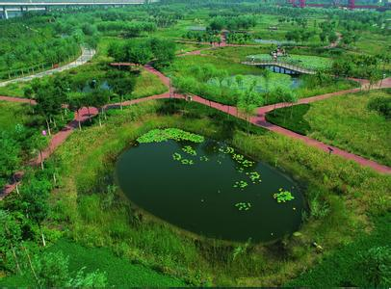
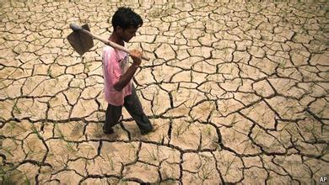
INTRODUCTION

Slide 3
Why Important?
Crop yields are forecasted to decrease by 30-46% before the end of the century even under the slowest climate warming scenario.
Farmers may adapt to the expected yield changes by growing crops more suited to the new climate.
Predicting adaptation behavior is therefore an important part of evaluating the effect of climate change on food and fiber production.

Slide 4
Research Question
How weather and soil determine crop location and how, in the face of warmer weather, crop adaptation varies across quality levels of soil.
  Panel data for 10 years from a group of US states situated in a north-south transect along the Mississippi-Missouri river system.

Slide 5
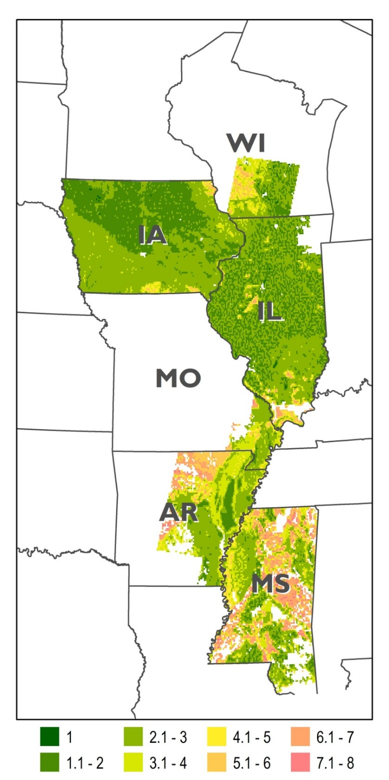
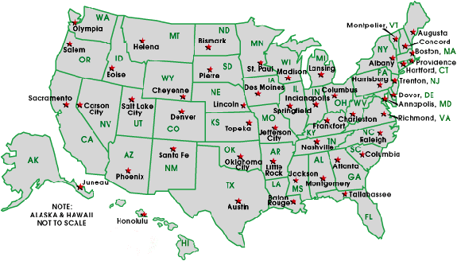
Where
Parts of 6 states making up the cornbelt.
Size. The line is 840km. Here to Bremen. Top to bottom, here to Marseille.
Notes:
Soil properties are a major determinant of which crops can be grown and what the crop’s ultimate yield is. It is very plausible that, even in the face of the same level of warming, crop shifting patterns will be very different across soils of different qualities.
The choice of crops to fit climate may be limited by soil conditions. Where crops of a certain type can be grown and what their maximum potential yields may be are determined not only by weather but also by soils. If all crops suitable to local soils are negatively affected by warming, it is possible that farmers are left with no better crop to substitute to.
In this paper, we show that, due to soil restriction, adaptation makes some difference, but that it does not undo the negative effects of higher temperature.

Slide 6
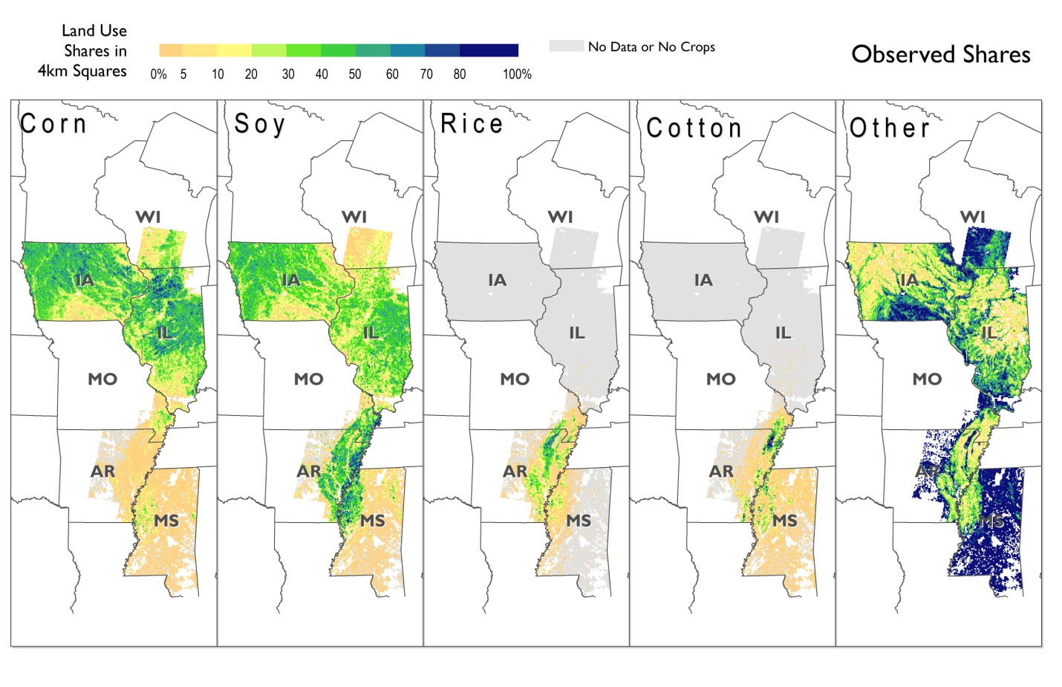
Figures 1: Observed Crop Coverage along the Mississippi-Missouri River System
Notes: Graphs display observed coverage shares for corn, soy, rice, cotton, and other land use, in the six states along the Mississippi-Missouri river corridor. They are average shares over 2002-2010.
Notes:
Along the Mississippi River, the dominant crop types are corn, soy, cotton and rice in the south and corn and soy in the colder north. Based on temperature alone, adaptation to higher temperatures should result in the northward spread of cotton and rice and substitution of shorter-season crops (e.g., soy) for longer-season crops (e.g., corn). However, agricultural crop coverage is not determined by temperature alone, or even rainfall and temperature taken together.

Slide 7
Figure 2: Distribution of Land Capability Classification (LCC) Levels
Prime agricultural soils are absent in southern Iowa and so largely is the corn-soy complex. Similarly, more optimal soils hug the river in Missouri and Arkansas, and so do rice and cotton.
Notes: Land Capability Class (LCC) 1 is the best soil, which has the fewest limitations. Progressively lower classifications lead to more limited uses for the land. LCC 8 means soil conditions are such that agricultural planting is nearly impossible.
Notes:
Soil properties are a major determinant of which crops can be grown and what the crop’s ultimate yield is. It is very plausible that, even in the face of the same level of warming, crop shifting patterns will be very different across soils of different qualities.
The choice of crops to fit climate may be limited by soil conditions. Where crops of a certain type can be grown and what their maximum potential yields may be are determined not only by weather but also by soils. If all crops suitable to local soils are negatively affected by warming, it is possible that farmers are left with no better crop to substitute to.
In this paper, we show that, due to soil restriction, adaptation makes some difference, but that it does not undo the negative effects of higher temperature.

Slide 8


Compare Soil and Corn

Slide 9
Modern Econometric Studies…
Nerlove’s (1956) examination of crop share response to crop prices
  Coverage is a function of lagged coverage, crop price, input prices and other variables.
Many ways to elaborate on this basic model
  Price
    Even the futures price is not predetermined! IV is likely needed always. Wheat rust, known to all but the econometrician.
  Risk
    Often the coefficient of variation
  Sum-up condition
    Logit in theory, but see below for the real problems with this.
  Spatial correlation
    Omitted variables change slowly over the landscape. Cause spatial autocorrelation.

Slide 10
DATA

Slide 11
Data Summary
Geospatially explicit data on
  Land cover
  Soil characteristics
  Weather
  Climate change scenarios
4km by 4km grid
10 years
Iowa, Illinois, Mississippi, and part of Wisconsin, Missouri, and Arkansas

Slide 12
Data: Land Use
Cropland Data Layer (CDL) available annually from 2000 to 2010 (USDA NASS) for the six states.
Land cover is divided into
  Major crops
  Other crops Agricultural land
  Non-crop and wild land (denominator)
  Urban and water bodies

Slide 13
Accuracy
The limiting factor in accuracy is the number of ‘ground truthed’ plots.
  Large crops like corn and soy, high accuracy.
  Minor crops, like oats, pasture, irrigated pasture, low accuracy
  Hence the aggregate category of wild and minor.

Slide 14
Data: Soil Characteristics
USDA’s U.S. General Soil Map (STATSGO2)
  Percent clay, sand, and silt, water holding capacity, pH value, electrical conductivity, slope, frost-free days, depth to water table, and depth to restrictive layer
A classification system generated by the USDA
  Land Capability Class (LCC)

Slide 15
Data: Weather Variables
PRISM data processed by Schlenker and Roberts (2009)
  A 4km by 4km spatial resolution
  With a daily level of temporal resolution
Degree days are calculated from daily highs and lows.
  Using a fitted sine curve to approximate the amount of hours the temperature is at or above a given threshold (Baskerville & Emin, 1969)

Slide 16
Fewer bins and more months
We process the degree days by broad bins,
  Above 10 planting, cotton above 15
  Above critical (e.g. 29 corn, 30 soy, and 32 cotton and rice.)
And then classify weather further by months and planting or growing season.
Add interaction between over 30c and precip. By month.

Slide 17
Weather has cross section variation
North to South
  Cold to hot
East to West
  Wet to dry

Slide 18
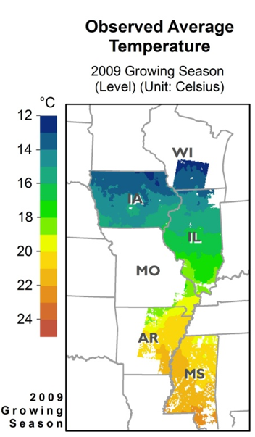
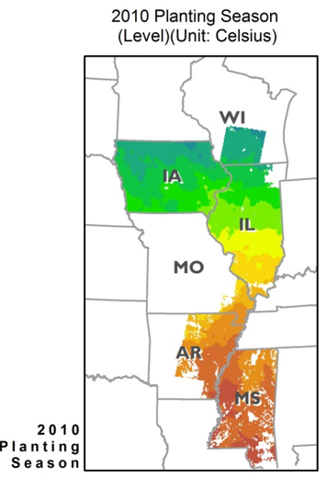

Slide 19
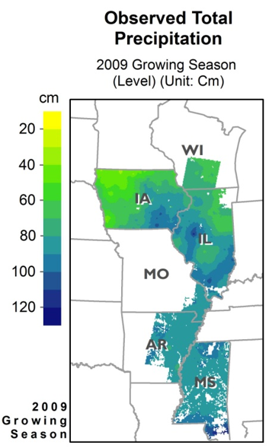
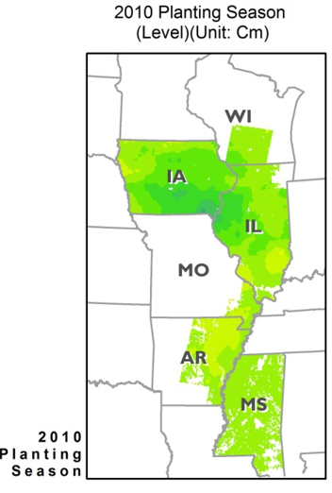

Slide 20
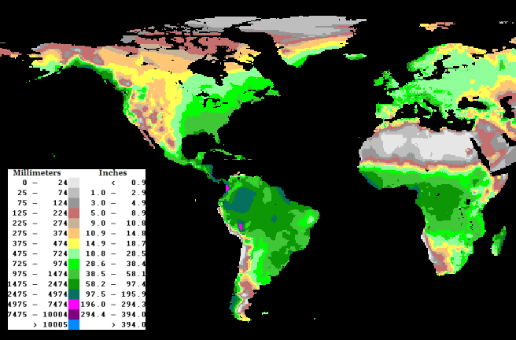
Comparison: Sweden is drier than Midwest

Slide 21
Data: Climate Change Scenarios
Climate Wizard (http://www.climatewizard.org/)
  Ensemble average, SRES emission scenario
  A1B and A2
  PDF’s of 4km squares, for 2080, of Temperature and Precipitation

Slide 22
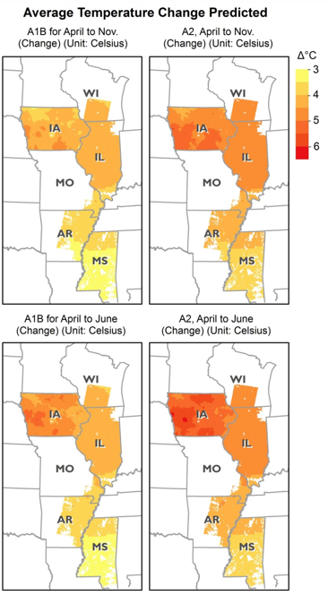
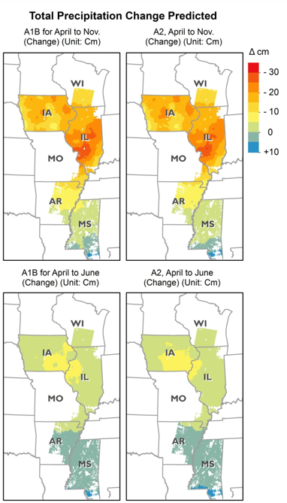

Slide 23
ECONOMETRIC SYSTEM

Slide 24
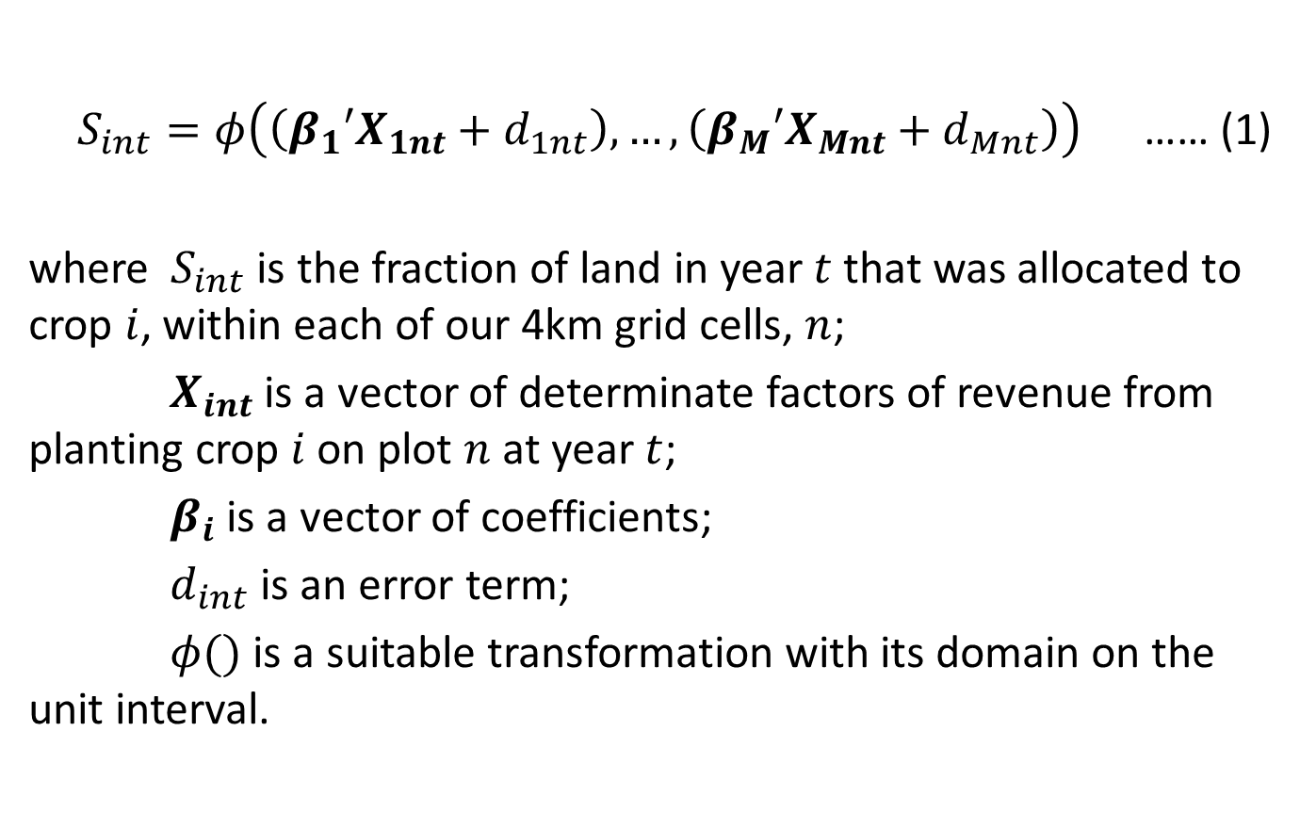
A Proportion Type Model
$S_{int}=φ\left(\left({β_{1}′X}_{1nt}+d_{1nt}\right), …,\left({β_{M}′X}_{Mnt}+d_{Mnt}\right)\right)$ …… (1)
where $S_{int}$ is the fraction of land in year $t$ that was allocated to crop $i$, within each of our 4km grid cells, $n$;
$X_{int}$ is a vector of determinate factors of revenue from planting crop $i$ on plot $n$ at year $t$;
$β_{i}$ is a vector of coefficients;
$d_{int}$ is an error term;
$φ()$ is a suitable transformation with its domain on the unit interval.

Slide 25
Considerations for a transformation for a proportions models
Linear estimation.
Many observations zero, many > zero.
No need to interpret as choice model.
Outside option, land not in major crops well measured.

Slide 26
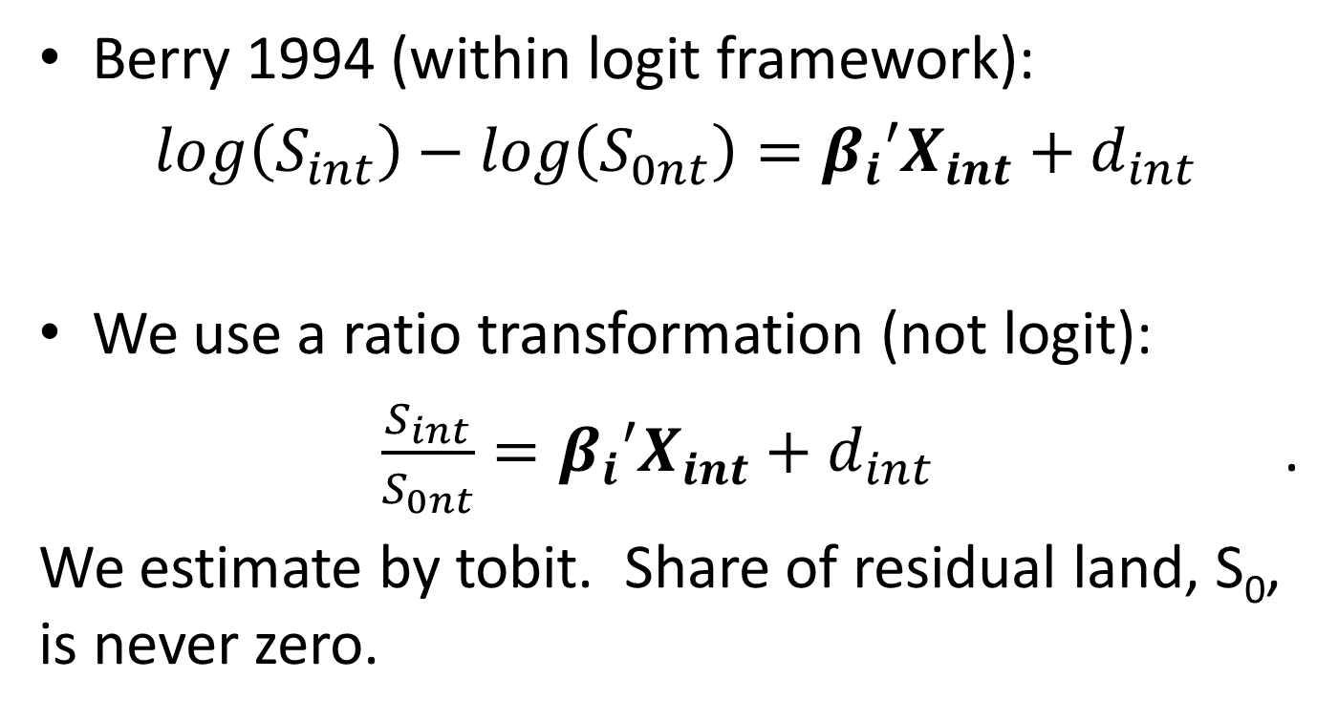
Choice of Form to estimate
Berry 1994 (within logit framework):
$\log\left(S_{int}\right)−\log\left(S_{0nt}\right)={β_{i}′X}_{int}+d_{int}$
We use a ratio transformation (not logit):
$\frac{S_{int}}{S_{0nt}}={β_{i}′X}_{int}+d_{int }$ .
We estimate by tobit. Share of residual land, S₀, is never zero.
Notes:
The estimation strategy is that first we estimate equation (2) by Tobit, accounting for the zero shares. Then we simulate $d_{jnt}$ ($j=1,…,M$) by taking draws from a left truncated normal distribution with mean 0, standard deviation $σ_{jnt}$and truncation at ${−β}_{i}{′X}_{jnt}$. Finally, we calculate $S_{int}$ for each draw and take the averages.

Slide 27
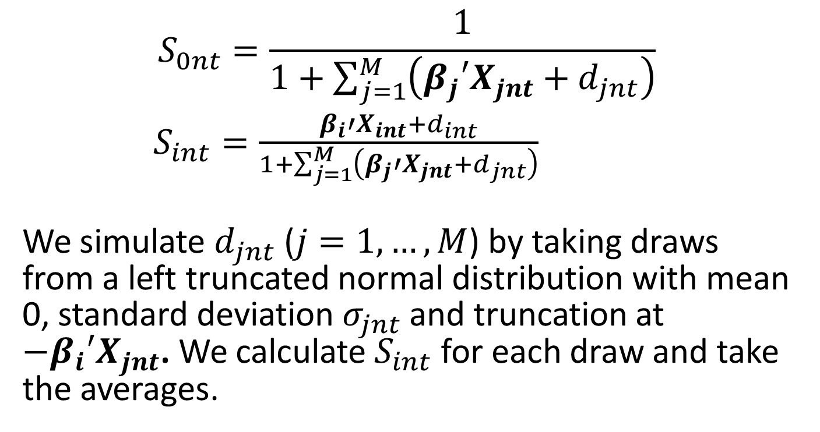
Expected shares
$$S_{0nt}=\frac{1}{1+\sum_{j=1}^{M}{\left({β_{j}′X}_{jnt}+d_{jnt}\right)}}$$
$S_{int}=\frac{β_{i}{′X}_{int}+d_{int}}{1+\sum_{j=1}^{M}{\left({β_{j}′X}_{jnt}+d_{jnt}\right)}}$
We simulate $d_{jnt}$ ($j=1,…,M$) by taking draws from a left truncated normal distribution with mean 0, standard deviation $σ_{jnt}$and truncation at ${−β}_{i}{′X}_{jnt}$. We calculate $S_{int}$ for each draw and take the averages.

Slide 28
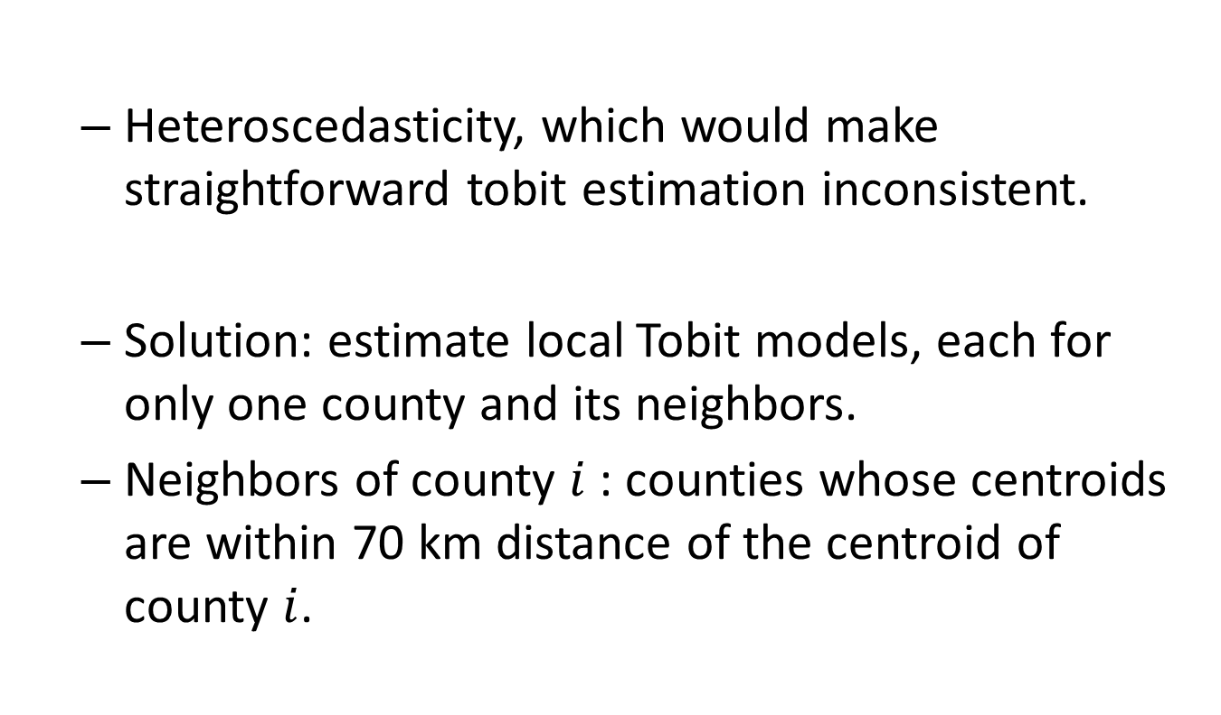
Spatial Correlation
  Heteroscedasticity, which would make straightforward tobit estimation inconsistent.
  Solution: estimate local Tobit models, each for only one county and its neighbors.
  Neighbors of county $i$ : counties whose centroids are within 70 km distance of the centroid of county $i$.

Slide 29
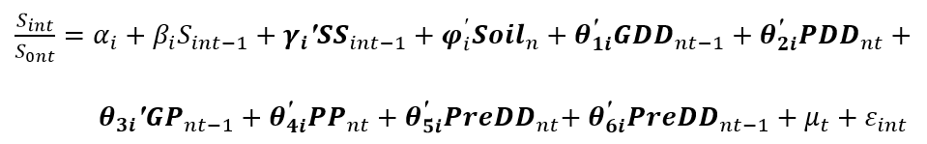
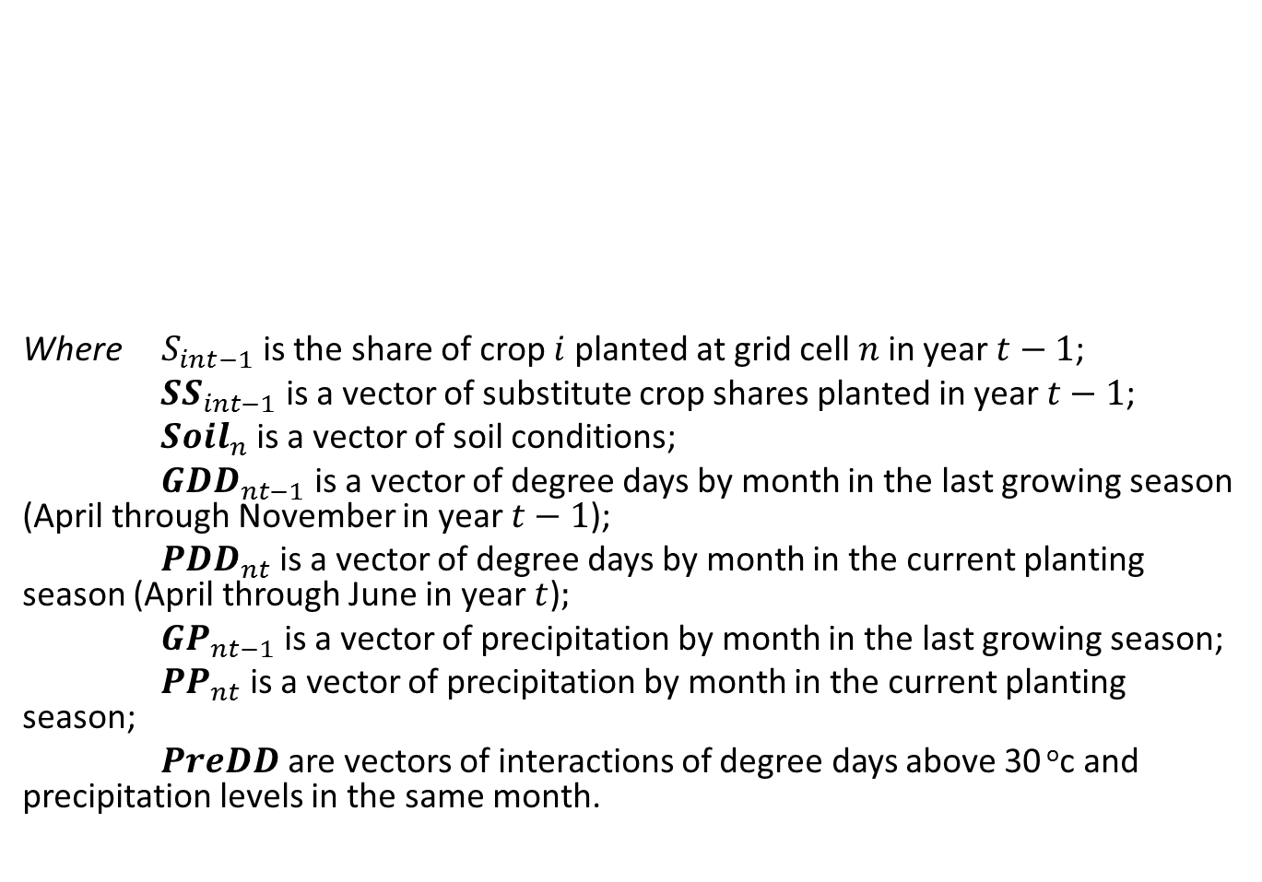
Explanatory Variables
Where $S_{int−1}$ is the share of crop $i$ planted at grid cell $n$ in year $t−1$;
${SS}_{int−1}$ is a vector of substitute crop shares planted in year $t−1$;
${Soil}_{n}$ is a vector of soil conditions;
${GDD}_{nt−1}$ is a vector of degree days by month in the last growing season (April through November in year $t−1$);
${PDD}_{nt}$ is a vector of degree days by month in the current planting season (April through June in year $t$)$;$
${GP}_{nt−1}$ is a vector of precipitation by month in the last growing season;
${PP}_{nt}$ is a vector of precipitation by month in the current planting season;
$PreDD$ are vectors of interactions of degree days above 30 ºc and precipitation levels in the same month.

Slide 30
ESTIMATION RESULTS

Slide 31
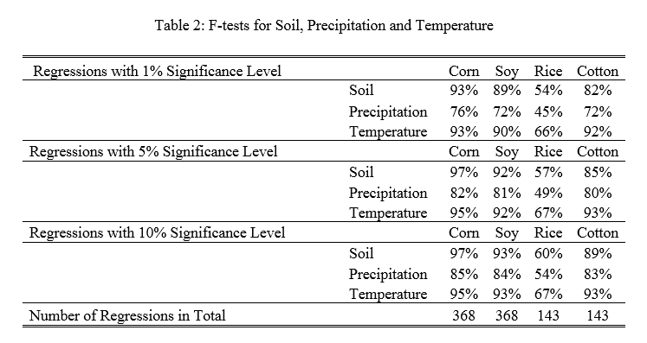
Significance

Slide 32
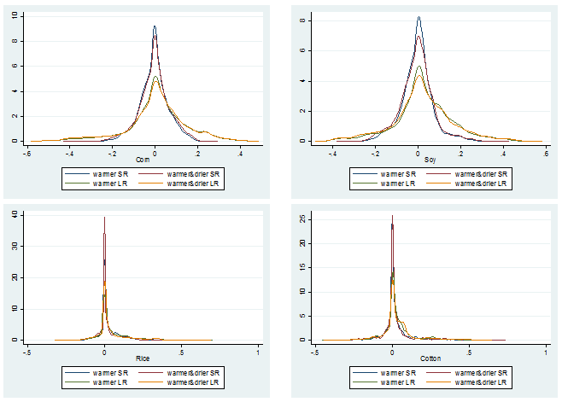
Simulation for Unit Change in Weather
Figure 4: Distribution of Crop Share Changes with Unit Change in Temperature and Precipitation
Notes:
Here the distribution is across the landscape.

Slide 33
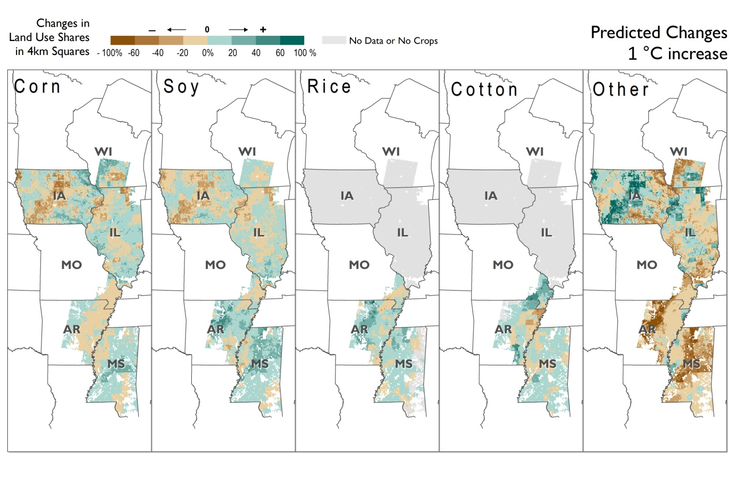

Slide 34
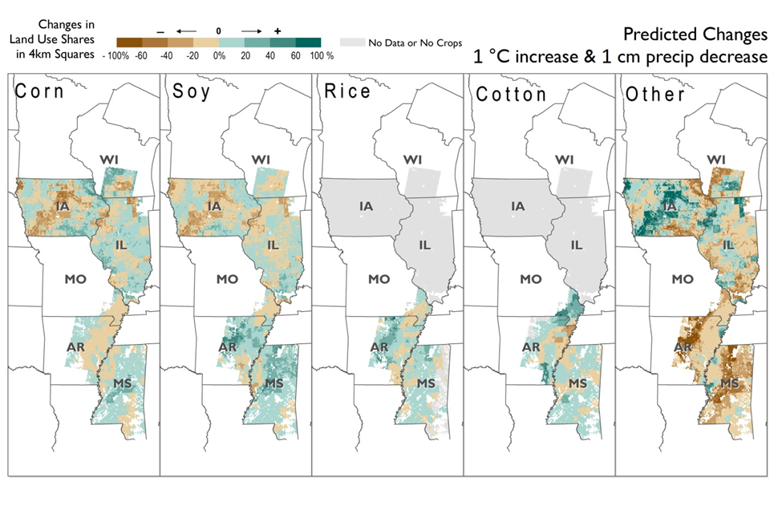

Slide 35
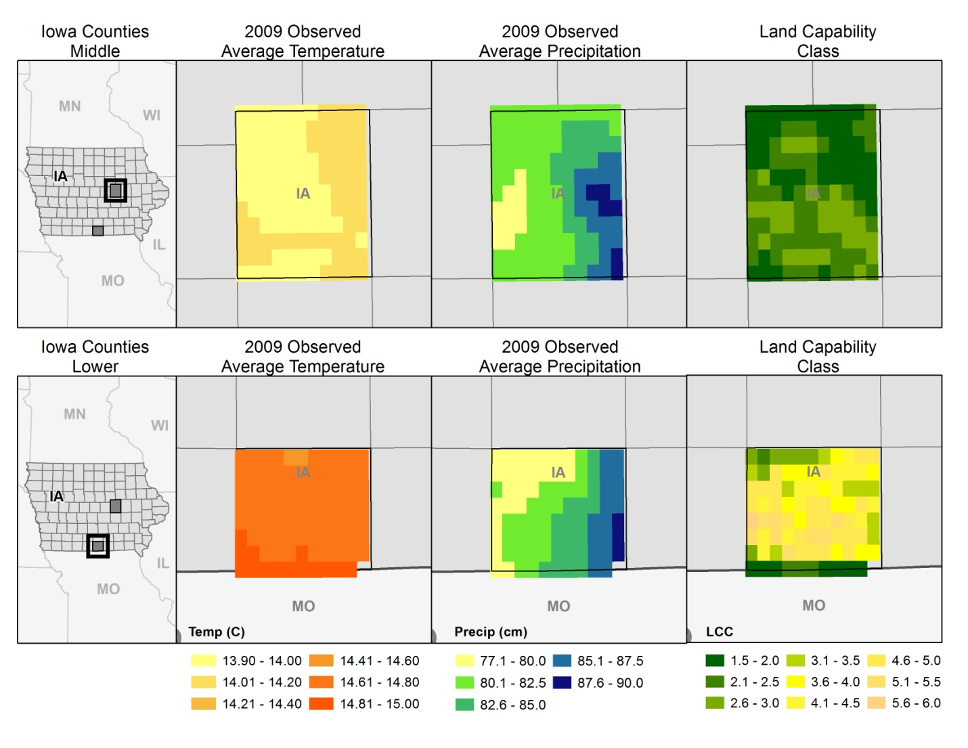
How Soil Affects Crop Adaptation…

Slide 36
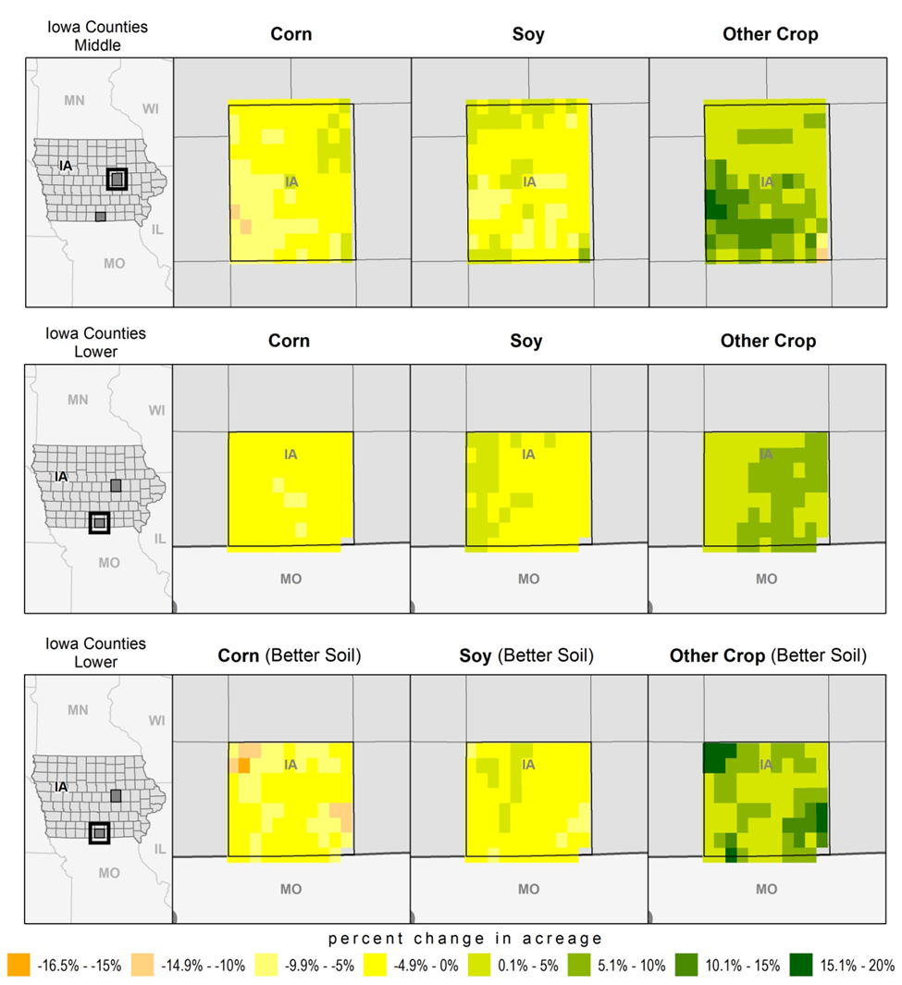
Notes:
1c change in temperature.
Middle as in.
Bottom with soil and coeffs of middle, that is only climate differs.

Slide 38
CLIMATE CHANGE IMPACTS

Slide 40
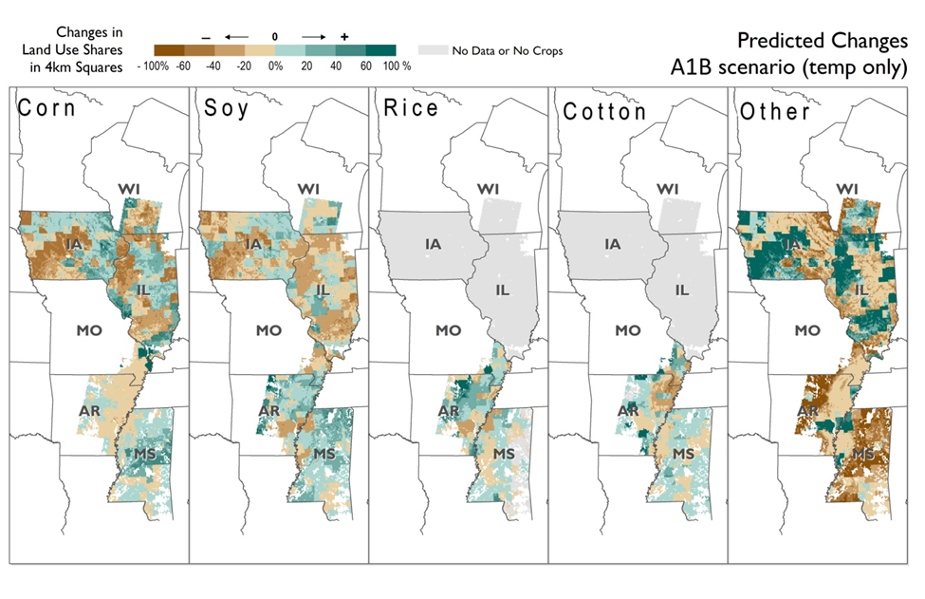

Slide 41
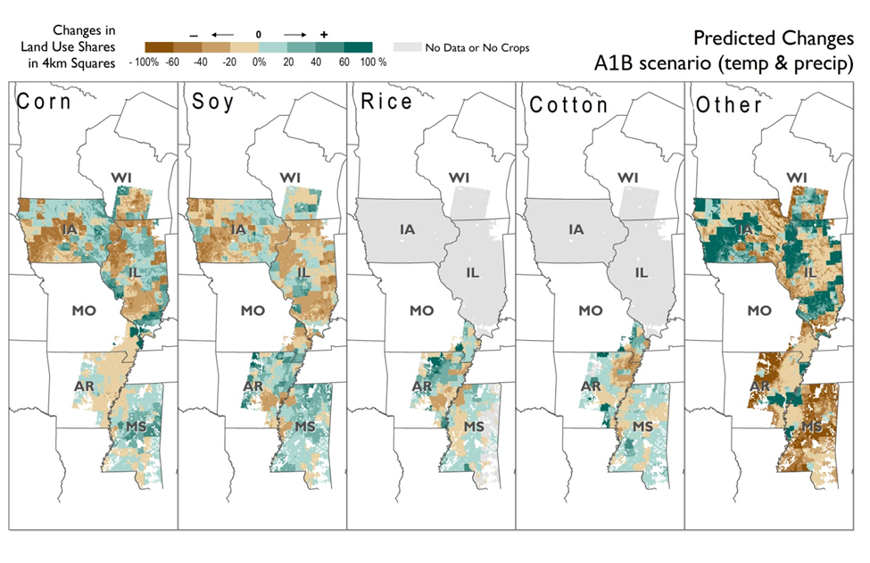

Slide 42
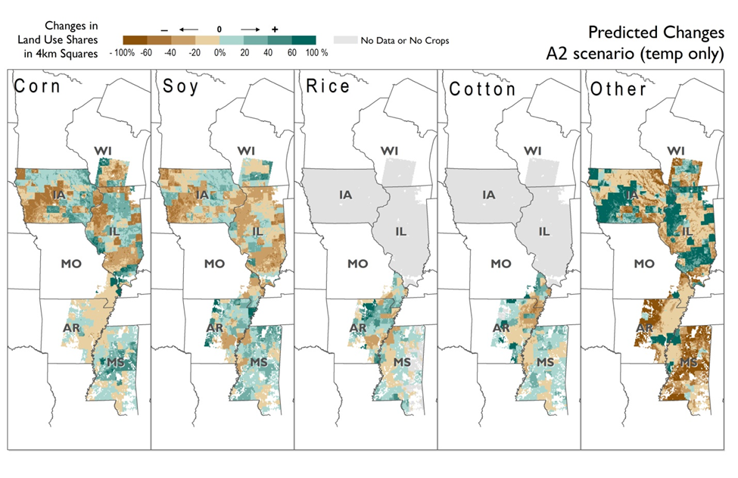

Slide 43
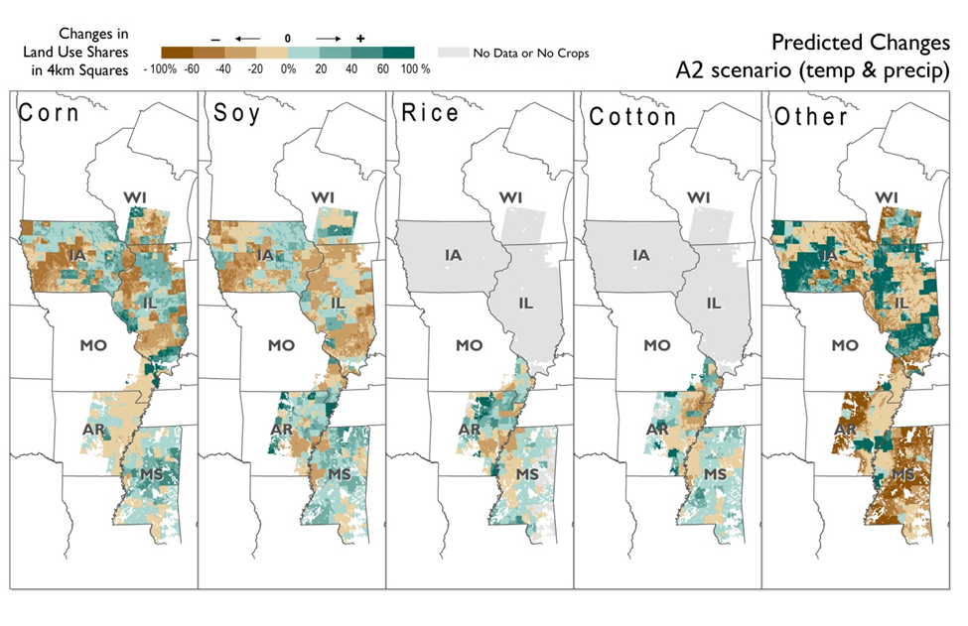

Slide 44
CONCLUSION

Slide 45
Rice and cotton spread north, while the average shares of corn and soy decrease in the north and increase in the south.
There is less crop adaptation on prime soils than on lower quality soils.
A significant makeover of major crop distribution is not likely to happen.

